Slide 1


Slide 2
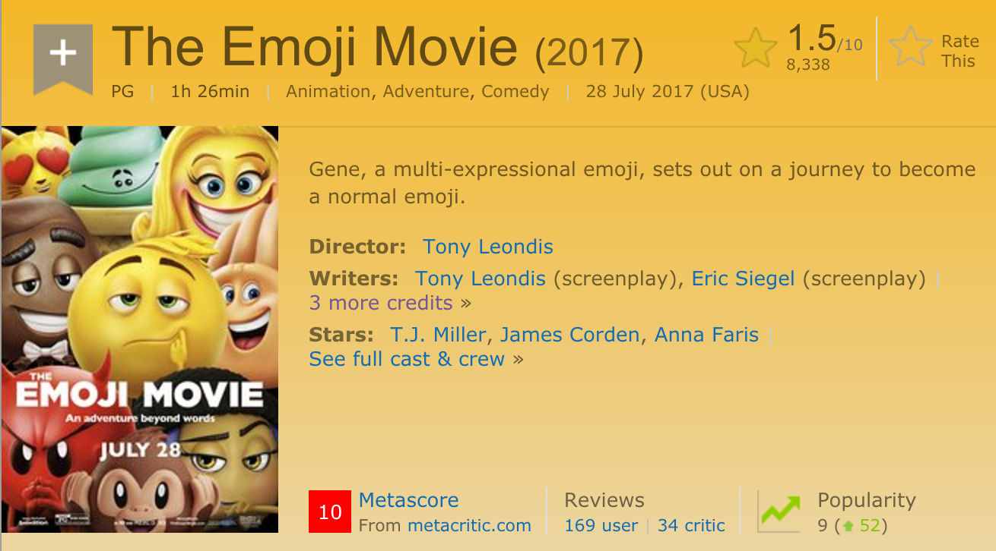

Slide 3
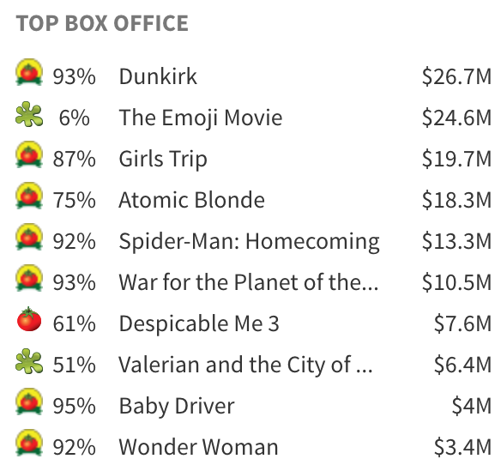

Slide 4
Big Data Analytics Symposium - Summer 2017
Analytics Project:
The impact of social media propaganda on the film market in North America
Team: Yuqian Zhang
Abstract: The study is focus on the analytics of the relationship among movie box office results, professional ratings and social media propaganda effect.

Slide 5
The impact of social media propaganda on the film market in North America
Motivation
Who are the users of this analytic? film investors, related professionals
Who will benefit from this analytic? film investors, related professionals
Why is this analytic important?
to give film investors an idea of professional rating and social media propaganda’s influence on movie box office and their impact on nowadays film market
to provide related professionals a clue of the most popular movie genre on the customers’ side

Slide 6
The impact of social media propaganda on the film market in North America
Goodness
What steps were taken to assess the ‘goodness’ of the analytic?
[Gross] the gross value of different genres of movies and get what genres are most popular and profitable
[Professional rating & Gross ] the rating score, amount of reviews and review users of different types of movies
[Facebook likes & Gross] the social media factors analysis based on the Facebook likes movie-related data.

Slide 7
The impact of social media propaganda on the film market in North America
Data Sources
Name: IMDB
Description: The Internet Movie Database, the world's most popular and authoritative source for movie, TV and celebrity content
Size of data: MB

Slide 8
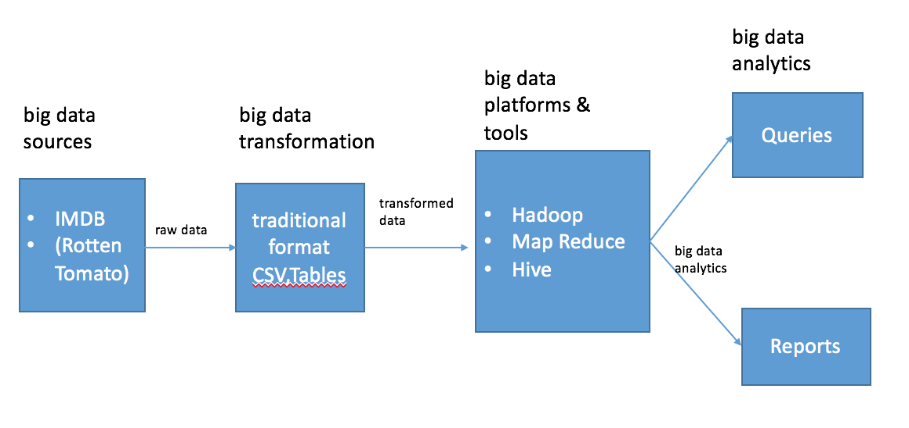
The impact of social media propaganda on the film market in North America
Design Diagram
Platform(s) on which the analytic ran:
NYU HPC cluster

Slide 9
The impact of social media propaganda on the film market in North America
Results
1. The most profitable movie genres are not dominated by professional point of view.
2. My hypothesis of social media propaganda does play an important role in the movie box office is right.
3. And the movie’s box office might be proportional to its social media propaganda.

Slide 10
The impact of social media propaganda on the film market in North America
Obstacles
1. To adjust the IMDB score
2. To make the multi – factor combination of the Facebook likes

Slide 11
The impact of social media propaganda on the film market in North America
Summary
Social media propaganda plays a key role in the movie box office result and it has a close contact with the profit of the movie.
Give film investors an insight of how powerful social media propaganda is. By learning its commercial importance and strategy, the film investors will be able to benefit a great many.
For script writers, they could get a clue through the report about what kind of film people are more inclined to currently in order to make their work meet the times and get a chance to hit the board.
Acknowledgements
https://github.com/sundeepblue/movie_rating_prediction

Slide 12
The impact of social media propaganda on the film market in North America
References
T. White. Hadoop: The Definitive Guide. O’Reilly Media Inc., Sebastopol, CA, May 2012.
A. Gates. Programming Pig. O’Reilly Media Inc.,Sebastopol, CA, October 2011.
J. Dean and S. Ghemawat. MapReduce: Simplified data processing on large clusters. In proceedings of 6th Symposium on Operating Systems Design and Implemenation, 2004.
S. Ghemawat, H. Gobioff, S. T. Leung. The Google File System. In Proceedings of the nineteenth ACM Symposium on Operating Systems Principles – SOSP ‘03, 2003.
Mining Chinese social media UGC: a big-data framework for analyzing Douban movie reviews

Slide 13
The impact of social media propaganda on the film market in North America
Thank you!

